Slide 1

DATABASE SYSTEM
Pandemic Monitoring System
Presented By
Hafiz Sarmad 22024119-074

Slide 2
Objectives
Providing accurate and up-to-date information about the current state of a pandemic, including the number of confirmed cases, deaths, and recoveries.
Providing a central location for individuals to access information and resources related to the pandemic.
Providing resources and guidance for individuals and communities to protect themselves and reduce the spread of the disease.

Slide 3
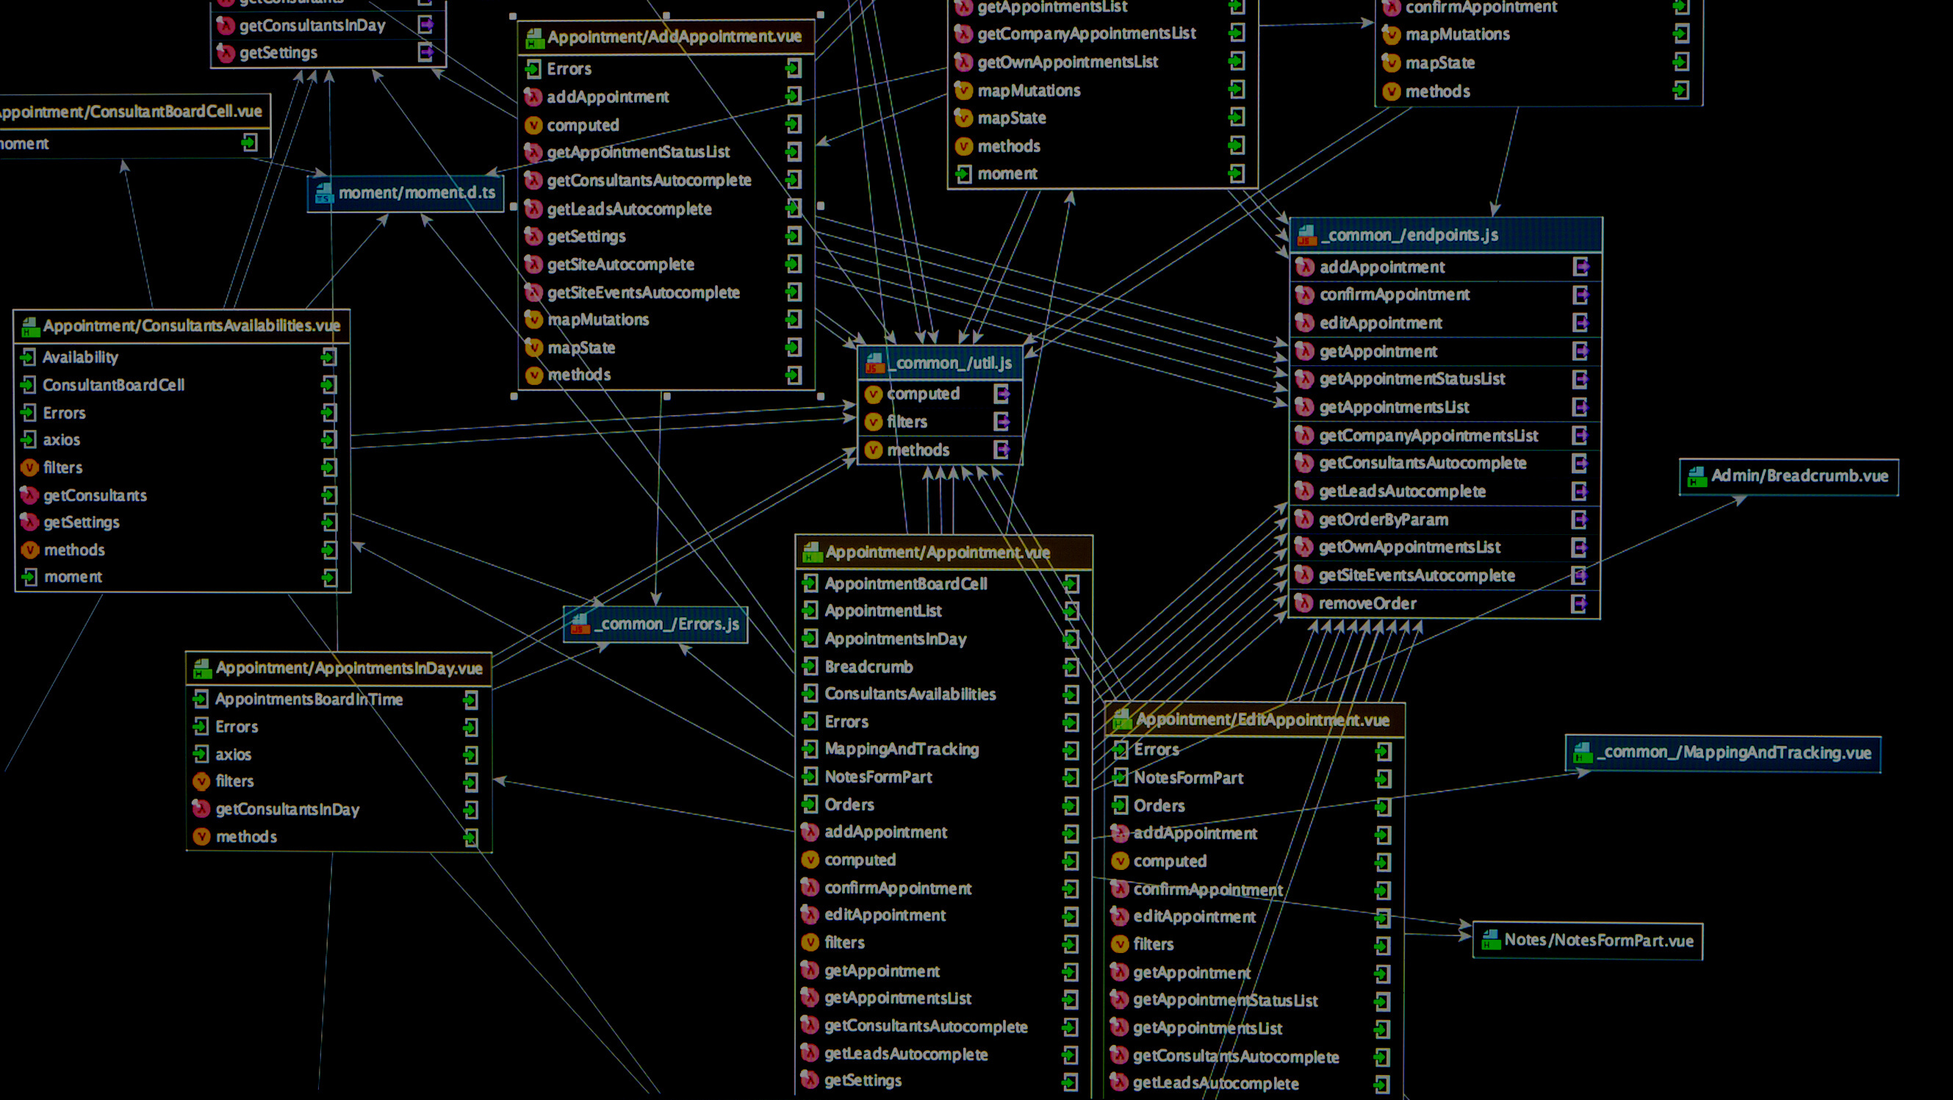

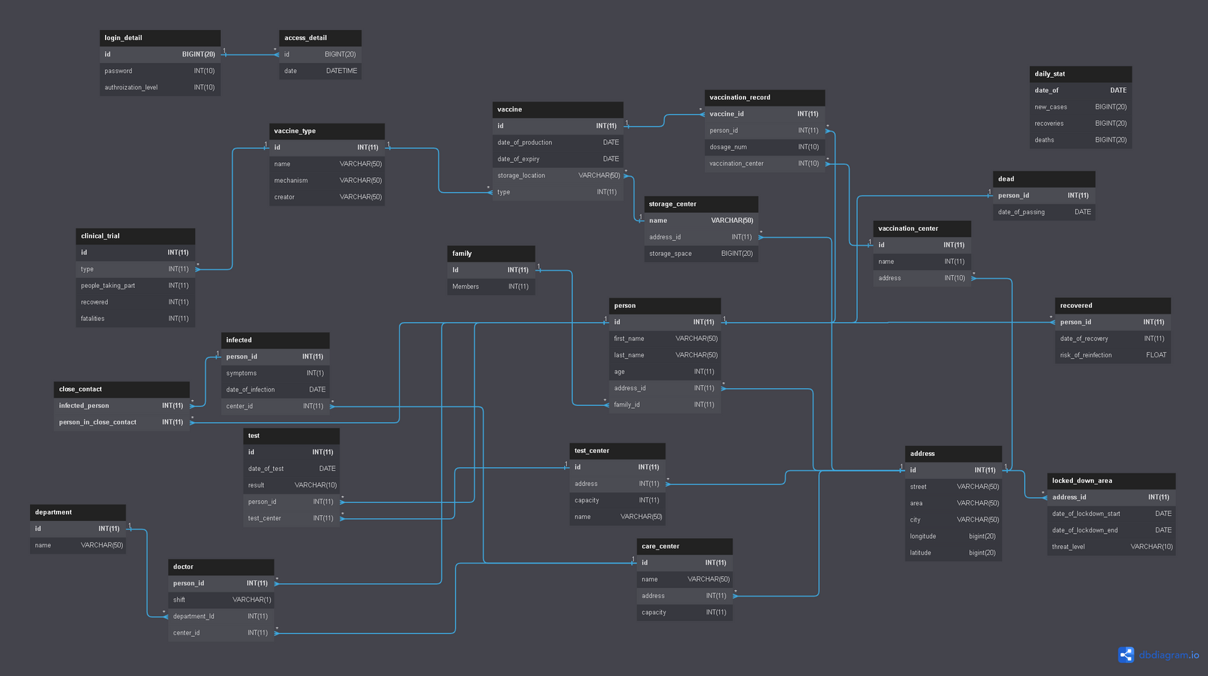
ERD

Slide 4

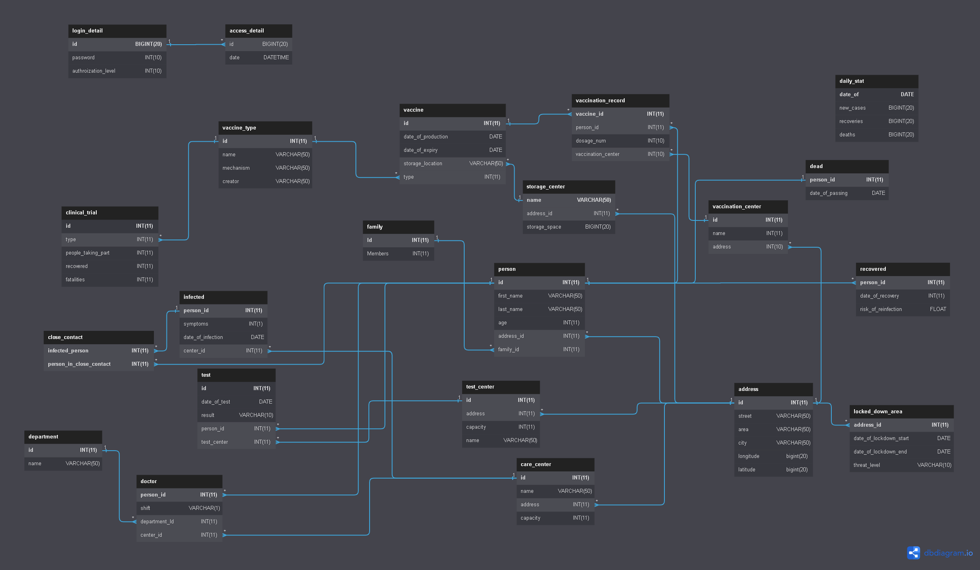
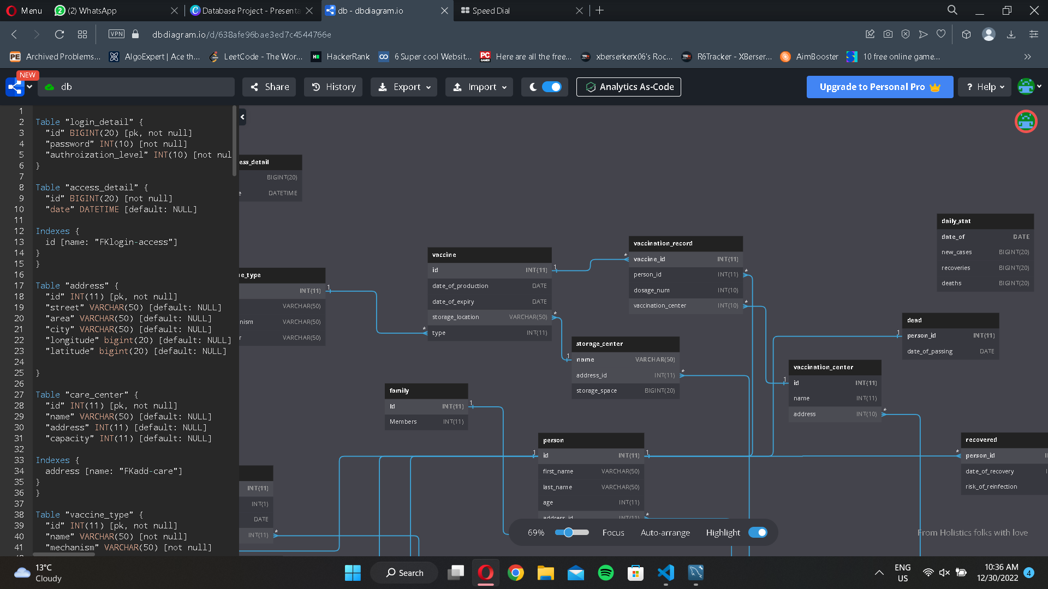
Admin Portal
Stats

Slide 5




Other
Features
1
2
2
Stored Procedures
Views

Slide 6

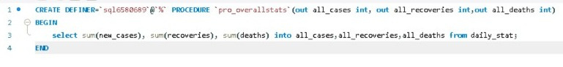
Stored Procedures
// Create a command to call the stored procedure
MySqlCommand command = new MySqlCommand("pro_overallstats", connection);
command.CommandType = CommandType.StoredProcedure;
// Declare the output parameters
MySqlParameter allCasesParam = new MySqlParameter("all_cases", MySqlDbType.Int32);
allCasesParam.Direction = ParameterDirection.Output;
command.Parameters.Add(allCasesParam);
MySqlParameter allRecoveriesParam = new MySqlParameter("all_recoveries", MySqlDbType.Int32);
allRecoveriesParam.Direction = ParameterDirection.Output;
command.Parameters.Add(allRecoveriesParam);
MySqlParameter allDeathsParam = new MySqlParameter("all_deaths", MySqlDbType.Int32);
allDeathsParam.Direction = ParameterDirection.Output;
command.Parameters.Add(allDeathsParam);
// Execute the stored procedure
command.ExecuteNonQuery();
// Retrieve the output values
int allCases = (int)allCasesParam.Value;
int allRecoveries = (int)allRecoveriesParam.Value;
int allDeaths = (int)allDeathsParam.Value;

Slide 7
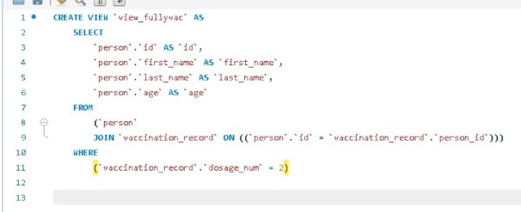
Views
MySqlCommand command = new MySqlCommand("SELECT * FROM view_closecontact", connection);
// Execute the view and retrieve the results
MySqlDataReader reader = command.ExecuteReader();

Slide 8

Future Prospects
Integration with other systems: Pandemic monitoring systems could be integrated with other systems, such as electronic health records, to more effectively track the spread of diseases and identify potential outbreaks.
Personalized recommendations: Pandemic monitoring systems could use machine learning algorithms to provide personalized recommendations for individuals based on their specific risk factors and location.

